Slide 1
Opportunity Cost / Economics
Tarlan Rasulov

Slide 2
What is Economics?
Opportunity cost is the cost of a decision in terms of the best alternative given up to achieve it.
Four forms of opportunity cost:
Opportunity cost and consumers
Opportunity cost and workers
Opportunity cost and producers
Opportunity cost and the government

Slide 4
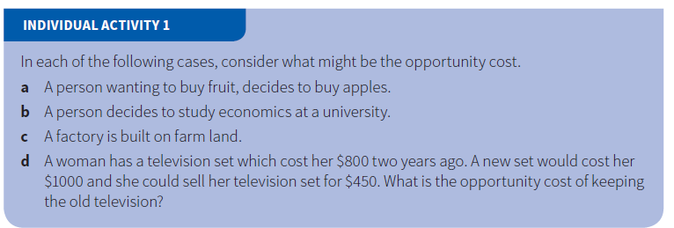

Slide 6
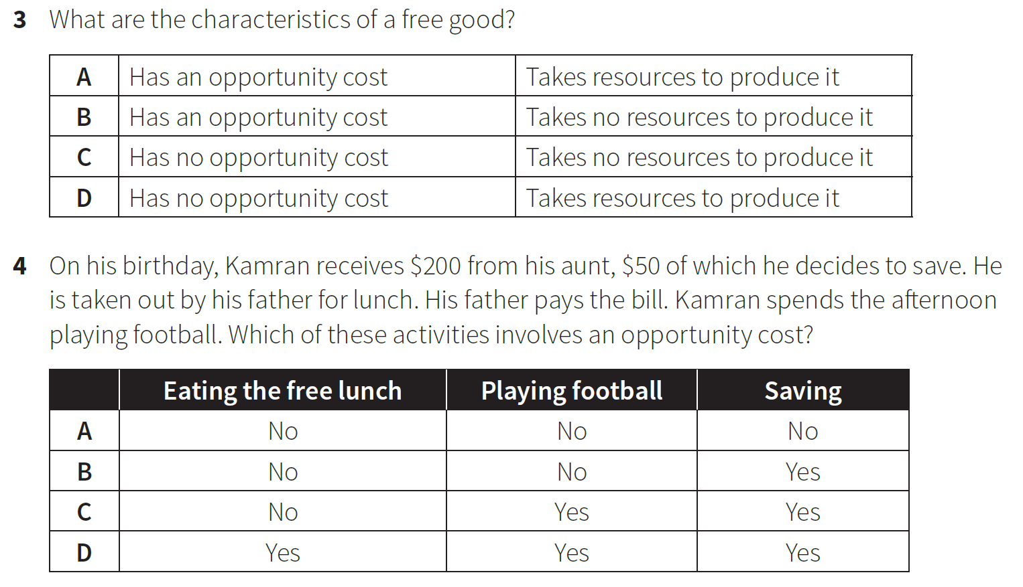

Slide 7
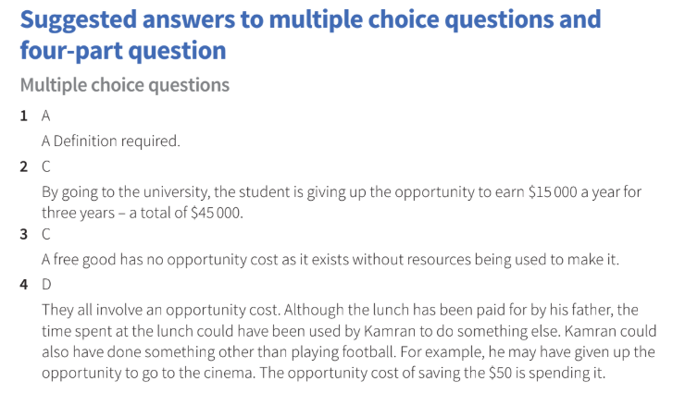

Slide 8
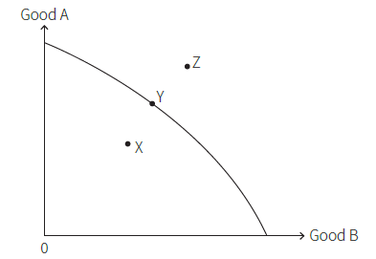
Economic goods and free goods
Production Possibility Curve - It shows the maximum output of two types of products, and combinations of those products that can be produced with the existing quantity and quality of resources and technology.

Slide 14
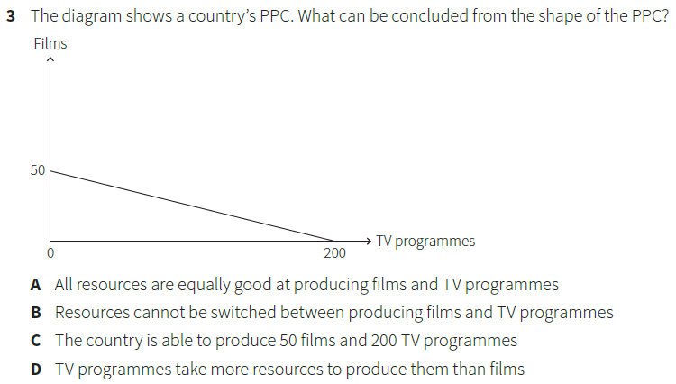

Slide 15
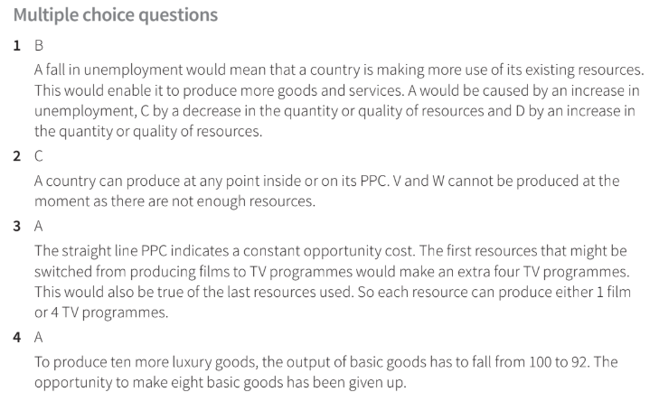

Slide 16
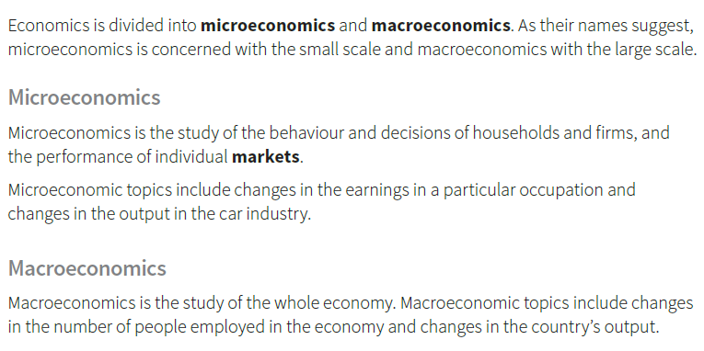

Slide 17
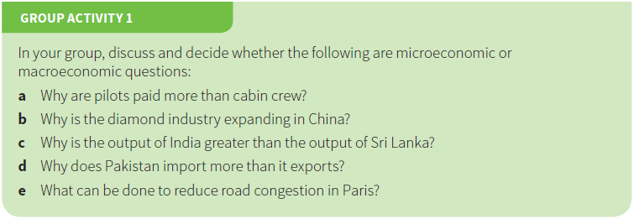

Slide 22
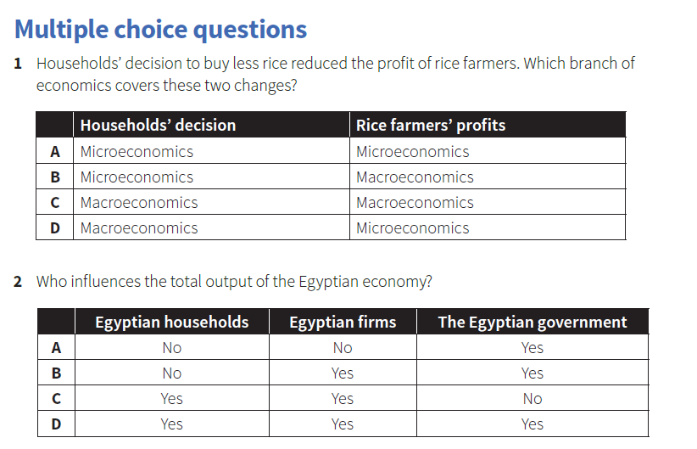

Slide 24
Thank You

